Slide 1
Gender Equity in Islam
By – Shivani Tiwari

Slide 2
Introduction

Slide 3
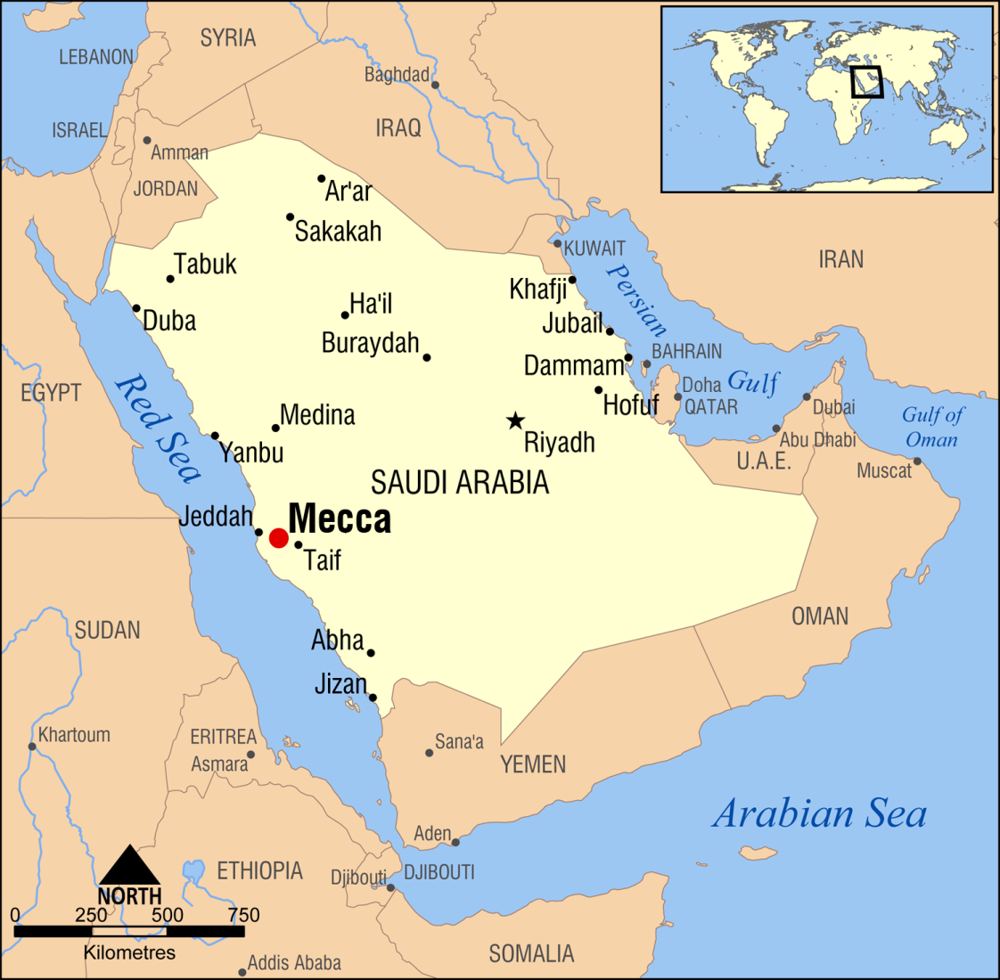
Map of Saudi Arabia

Slide 4

Soceity and women before the advent of Islam
‘Daur-e-Jahalat’
Male dominated soceity
Alcohol – a major problem
‘Dhat-er-Rayyat’

Slide 5
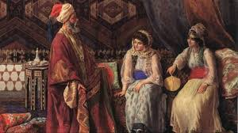
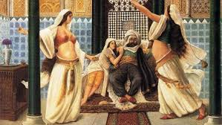
'Dhat-er-Rayyat'

Slide 6
Marriages (Nikah)
Marriages were of four types and in the present day only one type is followed . It is the one where a man betroths his ward or his daughter to another man, and the latter assigns a dower (bridewealth) to her and then marries her.
The other three types were different from the last one.

Slide 7
Prophet Muhammad's works to change the conditions
He preached that men and women are equal before God.
He created a set of rules – ‘Usul’
‘Gunaah-e-Saghira’
‘Gunaah-e-Kabira’
Three very important points mentioned in his set of rules :
For mothers
For daughters
For wives

Slide 8
Did people really follow his teachings?
Converts to Islam were impressed by his teachings.
Fear of God

Slide 9
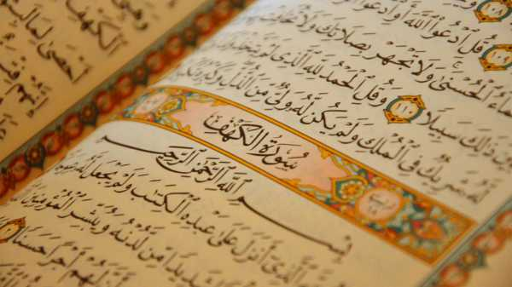

Slide 10
Improvements noticed :
Killing of female infants stopped
Women got rights over their husband’s property, business
Rights to reject the terms of proposal and right to divorce
Rapes decreased in number
Allowed to wear clothes according to their choice

Slide 11


